Slide 1


BER 210
STUDY UNIT 1:
HISTORY & SOURCES OF SA. LAW
Nagel et. al: Par 1.01 – 1.44
WEEK 1: 23 February - 28 February

Slide 2
LECTURING: WEEK 1 Ms N Mapefane
Work to be covered from 23 February – 28 February:
(See Module Structure on ClickUp and in Study Guide)
UNIT 1 THEME: INTRODUCTION WEEK 1 Nagel Chapter 1 - Par: 1.01 - 1.44

Slide 3
CONTACT DETAILS:
Email: nthope.mapefane@up.ac.za
(I will not answer an email outside normal business hours. Normal business hours are between 8:00 – 17:00.)
Email etiquette: Addressing lecturers formally and proper spelling.
Email Response Time: Between 48 and 72 hours (2 – 3 days) excluding weekends and public holidays.
CONSULTATION HOURS:
See Study Guide, under the heading titled “Contact Details”.
STUDY UNIT RELATED QUESTIONS:
Google Meet (Email me with 2 possible options on your side to schedule within my consult hours)
Contact (personally consult during my consultation hours.)
NB! Discussion Board (ClickUp)
Email (take note of the response time).

Slide 4
BER 210
UNIT 1
History

Slide 5
SA Legal history divides into 3 periods
Roman Law
Roman Dutch Law
SA LAW

Slide 6
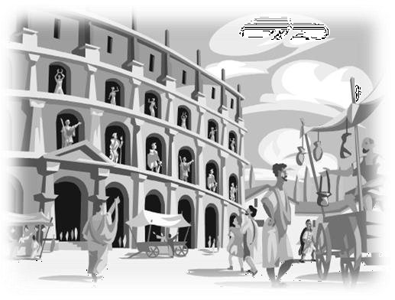


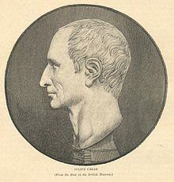


Roman Law
Period of the Kings
753BC – 510BC
Customary Law
Republican Period
510BC – 27BC
12 Tables
Period of the Emperors
27BC- 284AD
Significant development
Post-Classical Period
284AD – 565AD
Decline of legal system

Slide 7

Corpus Iuris Civilis
Justinian
Codex
Digesta Institute Novellae

Slide 8
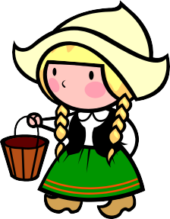

Roman-Dutch Law =
Roman Law
+
Law of Netherlands
(mainly consists of Germanic customary
law)

Slide 9

Roman-Dutch = SA common law
Basis of SA legal system
South African Law
=
Roman-Dutch Law
+
English Law
(4 factors which caused the English influence )

Slide 10


Law vs Rights
Law
Rule to obey
Enforced by the State
Peremptory or regulatory
Eg: Constitution
Rights
Legal right to legal object
4 Categories (NB!)
Eg: Right to live

Slide 11








RIGHTS
Legal Subject:
Legal Object
-Natural
– Juristic

Slide 12




Categories
1.Real Rights ownership
3. Intellectual Property Rights
- Copyright
- Trademark
2.Personal Rights
claim performance
4. Personality Rights
»
dignity
good name
honour
»
»
»

Slide 13
Sources of Law
Customs
Legislation
Court Decisions

Slide 14
CUSTOMS
Reasonable
Exist for a reasonable period
Be generally recognised in the community 4.It must be certain and clear.

Slide 15
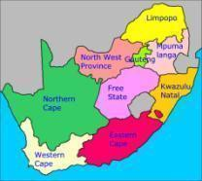


Legislation
Parliament
– Constitutional Court
Provincial Legislation
Subordinate Legislative Bodies

Slide 16

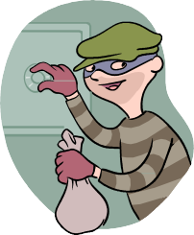
Court
Civil
2 parties litigate to resolve a
dispute
Burden of proof:
Balance of Probabilities.
Parties:
Plaintiff v Defendant
Applicant v Respondent
Eg: Stadler v Hamilton Plase
Decision
Grant or dismiss claim/ application/ interdict/declaratory order
Criminal
State prosecutes a legal subject for a crime
Burden of Proof: State must prove guilt beyond reasonable doubt
Parties:
State v Accused
EG: S v Kruger
Decision
Guilty + Sentenced / not guilty

Slide 17
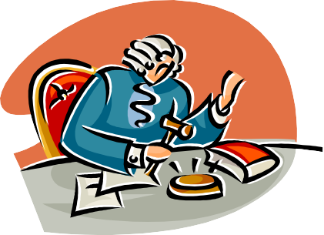




Courts
1.Higher Courts
Constitutional Court
(highest authority on all matters)
Supreme Court of Appeal
High Court (14 seats)
>R400 000/ >

Slide 18
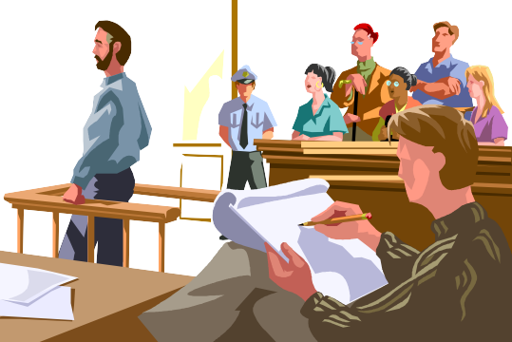
Courts
Lower Courts
Magistrates Courts
District Courts <R200 000/ <R120 000/3yrs
Regional Court <R400 000/ <R600 000/15yrs
Small Claims Court
– R20 000
No legal rep
Only natural persons

Slide 19


Appeals and Precedent
Appeals
From lower court to higher court
HC =Full bench
Precedent (Stare decisis)
Same court
From higher court to lower court
Ratio decidendi Obiter dictum

Slide 20
Precedent (stare decisis)
Constitutional Court
Supreme Court of Appeal
High Court
Full bench decision
Single judge
Magistrates’ Court – not bound by own decisions

Slide 21
Barkhuizen v Napier 2007 5 SA 323
(CC)
Barkhuizen
Napier
2007
5
SA
323
(CC)
Plaintiff / appellant
Defendant/ respondent
Reported in 2007 law reports
Volume 5
Reported in SA Law reports
Page
Constitutional Court

